Slide 1
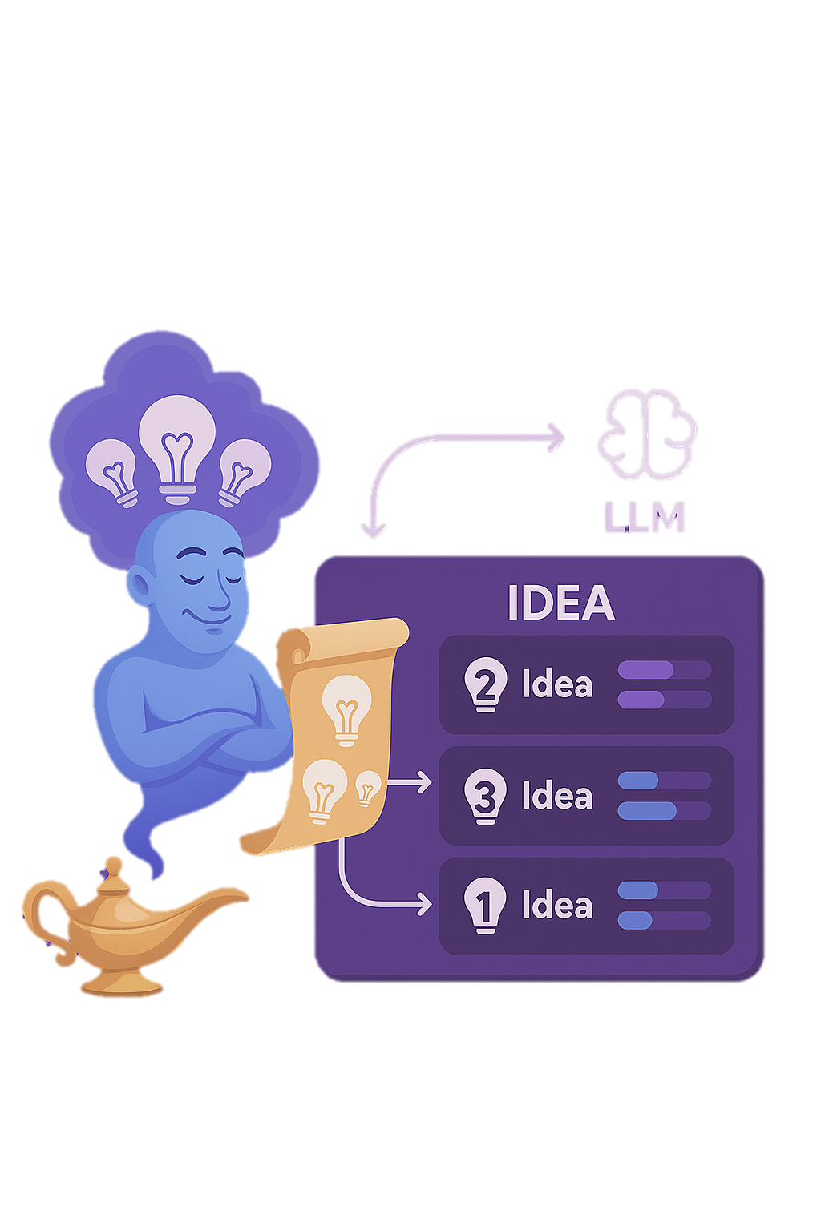



Luddy Hacks Case 1
IdeaGenie
AI Agent for Prioritizing Ideas using ReAct Framework
Helping teams move faster by building what truly matters – first!

Slide 2
Problem Statement Challenge:
Organizations collect hundreds of innovation ideas via platforms like ServiceNow. The challenge is to prioritize them efficiently.
Key Questions:
How do we balance implementation effort, ROI, and strategic alignment?
How can AI help in reasoning through this decision-making process?
Objective: Build an AI Agent that evaluates ideas using reasoning + action (ReAct), then ranks them with justifications.

Slide 3
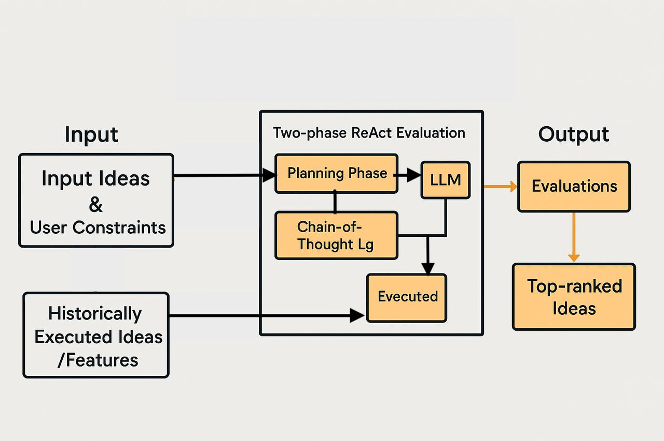
Solution Overview Architecture:
🧠 LLM-based ReAct Agent — Thinks & Acts in two phases.
🧮 Evaluation Metrics — Effort (Time, Resources), ROI (Value, Demand, Impact).
📦 Vector Search (FAISS) — Finds similar ideas for better context.
🧾 Logs & Justifications — Transparent and explainable decisions.
📊 Dashboard (React) — Visualizes Top 3 ideas with reasoning.
Log

Slide 4
ReAct Logic Breakdown Two-Phase Chain-of-Thought Process:
Planning Phase (Reasoning):
Decides if similar ideas should be retrieved.
Creates an evaluation plan.
Output: "Action: RetrieveSimilar" or "Action: NoRetrieve".
Finalization Phase (Action):
Executes evaluation using plan + context.
Outputs: Composite Score + Justification.
Bonus: Logs full plan, action, and final output for transparency.

Slide 5
How Our ReAct-Based AI Agent Meets the Requirements
✅ Effort & ROI Analysis → Uses LLM prompts with metrics like engineering hours, dependencies, revenue uplift, user impact.
✅ Top 3 Idea Selection → Automatically ranks ideas by composite score and justification.
✅ Explicit Reasoning (ReAct) → Two-phase logic: Plan (Reasoning) + Final Evaluation (Action) with verbose logging.
✅ Mock Dataset + Similarity Search → Realistic idea dataset and FAISS-based retrieval of related past ideas.
✅ Explainability + Logs → Justifications and reasoning saved for clear audit and visualization.
💡 Future Ready → Modular design allows adding feedback loop for learning.

Slide 6
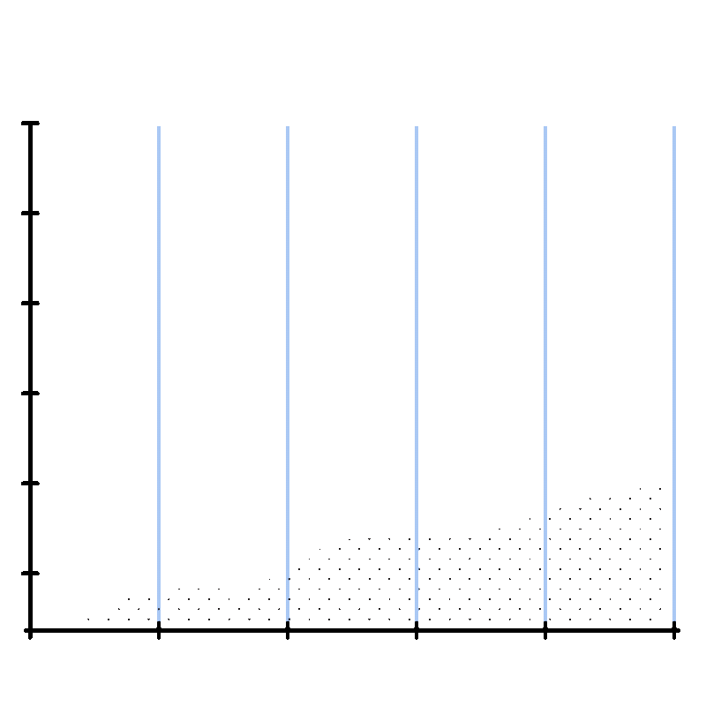

Lets Get Into Demo

Slide 7
THANK YOU!

